Slide 1
Welcome to Killearn Lakes Pre-K
Mrs. Killinger – Teacher
Mrs. Williams and Mrs. Heil --Para-professionals

Slide 2
Hours
Supervision begins at 8:00
School Day 8:30-2:50
VPK hours 8:30 -11:45

Slide 3
Class expectations
Keep mask on with numerous breaks.
Use your own materials and manipulatives.
Keep six feet away from friends.
Wash hands often.
Use hand sanitizer.

Slide 5
Things to know about Pre-K.
Curriculum Driven by PK Standards
Social Development
Literacy
and Math
Creative Curriculumn
Teaching Stratgies
Sanford Harmony

Slide 6
Discipline Policy
Approach calmly.
Acknowledge children’s feelings.
Gather info.
Restate the problem.
Ask for ideas and solutions and choose one together.
Be prepared to give follow up support.
We utilize the Problem Solving Approach

Slide 7
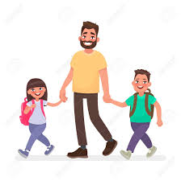
Volunteers
You could work from home.
Help the PTO organize activities.
Help plan and implement classroom actives.
Room Parent
coordinates.
We love our volunteers!

Slide 8
Pre-K Attire Please have your child wear comfortable clothes that protect them and can get dirty.

Slide 9
Snack is mid morning. Please send a healthy item to give your student energy and a mask break.
Breakfast and lunch will be provided free for those who wish. Children may also bring their own. Our class eats in the room.
.

Slide 10
Morning Routine
Go to desk and unpack.
Sign-in using composition books.
Hang up name card in attendance chart.
Play at desk!
Pledge & morning songs
Calendar
Daily attendance
Question of the Day

Slide 11
Sign up for the List Serve!
Be notified about important things that happen at school.
You will find it on the top right side of the school web page.

Slide 12
Conferences!
Will be virtual on Zoom or MS Teams.

Slide 13
Classroom Information
Newsletter will be emailed.
Folders go home last day of the week with a comment about your child’s week.
Please look at web page. There will be announcements and newsletters. ANNOUNCEMENT: Please send family picture with names of people in photo.
When your child is absent, please notify us with an excuse.
Homework: Practice printing name, naming letters, singing letter songs to learn letter sounds, recognizing numbers and counting to 30 or higher. Younger children work on naming colors and shapes, counting to 10, and naming letters.

Slide 14
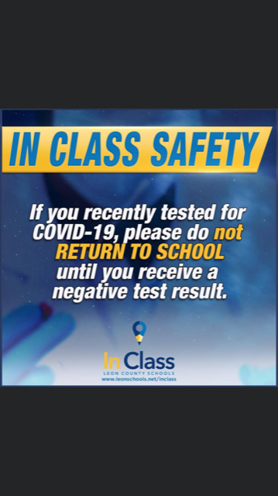

Slide 15
KLES School Improvement Goals 2021-22
Reading Goal:
Increase learning gains of the lowest 25% in ELA by at least 5% as demonstrated on the FSA ELA Assessment
Math Goal:
Increase learning gains of the lowest 25% in Math by at least 5% as demonstrated on the FSA Math Assessment.
Science Goal:
The percentage of 5th grade students performing at level 3 or above will increase at least 3% as demonstrated on the FCAT Science Assessment.
Parents if you have any questions or input … please feel free to email Mr. McGrotha mcgrothah@leonschools.net
Hank McGrotha, Vice Principal
Killearn Lakes Elementary School
8037 Deerlake Drive East
Tallahassee, FL 32312

Slide 16
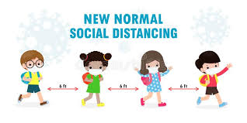
Thank you for watching! Hope you enjoyed learning about your child’s day.

